Slide 1
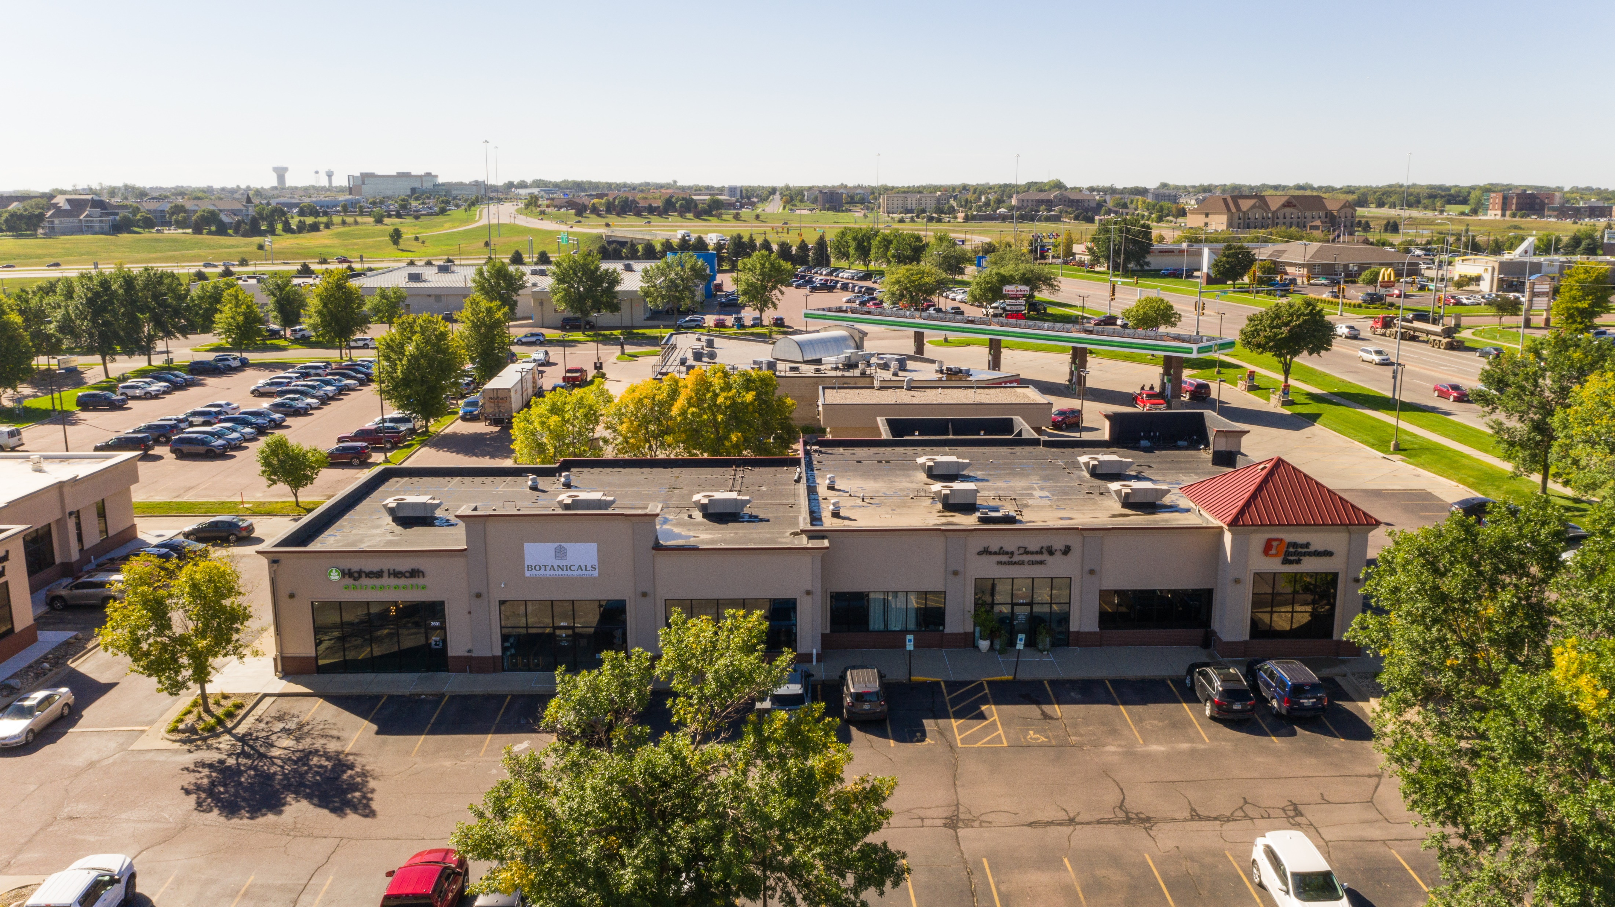
The Shoppes at 57th and Louise
Office | Retail
3605 W 57th St
Sioux Falls, SD 57108
Size
Price
Zoning
1,500-3,000
Square Feet +/-
Owner will subdivide
Base Rent:
$ 17.50 to $19.50 PSF
NNN: $6.80 PSF
C-3
Community
Commercial
Space Summary
Vanilla shell space ready for tenant build out specifications and requests, with pylon signage available
Less than a mile away from the Empire Mall and the surrounding shops and retail centers
Directly 1-mile north of expanding Avera’s Specialty Hospital and rapidly developing southwest Sioux Falls area with ample hotels and businesses
Nearby include Healing Touch Massage, First Interstate Bank, Honey Baked Ham
Tenant improvement allowance available for qualified Tenants
Samuel R. Assam | President
Phone: (605) 334-8040
Email: sam@assamcompanies.com
Address: 530 S. Phillips Ave, Sioux Falls, SD 57104

Slide 2
The Shoppes at 57th and Louise
Office | Retail
Rent Summary – 3,000sf
Component
PSF
Monthly
Annually
Base Rent |  | $ | 17.50 |  | $ | 4,375.00 |  | $ | 52,500.00
CAM* |  |  | 3.55 |  |  | 887.50 |  |  | 10,650.00
Real Estate Taxes* |  |  | 2.95 |  |  | 737.50 |  |  | 8,850.00
Property Insurance* |  |  | 0.35 |  |  | 87.50 |  |  | 1,050.00
Total |  | $ | 24.35 |  | $ | 6,087.50 |  | $ | 73,050.00
*Estimate
Floorplan
AVAILABLE
+/- 3,000
Healing Touch
VACANT
Samuel R. Assam | President
Phone: (605) 334-8040
Email: sam@assamcompanies.com
Address: 530 S. Phillips Ave, Sioux Falls, SD 57104

Slide 3
The Shoppes at 57th and Louise
Office | Retail
Rent Summary – 1,500sf
Component
PSF
Monthly
Annually
Base Rent |  | $ | 19.50 |  | $ | 2,437.50 |  | $ | 29,250.00
CAM* |  |  | 3.55 |  |  | 443.75 |  |  | 5,325.00
Real Estate Taxes* |  |  | 2.95 |  |  | 368.75 |  |  | 4,425.00
Property Insurance* |  |  | 0.35 |  |  | 43.75 |  |  | 525.00
Total |  | $ | 26.35 |  | $ | 3,293.75 |  | $ | 39,525.00
*Estimate
Floorplan
AVAILABLE
+/- 1,500
Healing Touch
VACANT
Samuel R. Assam | President
Phone: (605) 334-8040
Email: sam@assamcompanies.com
Address: 530 S. Phillips Ave, Sioux Falls, SD 57104

Slide 4
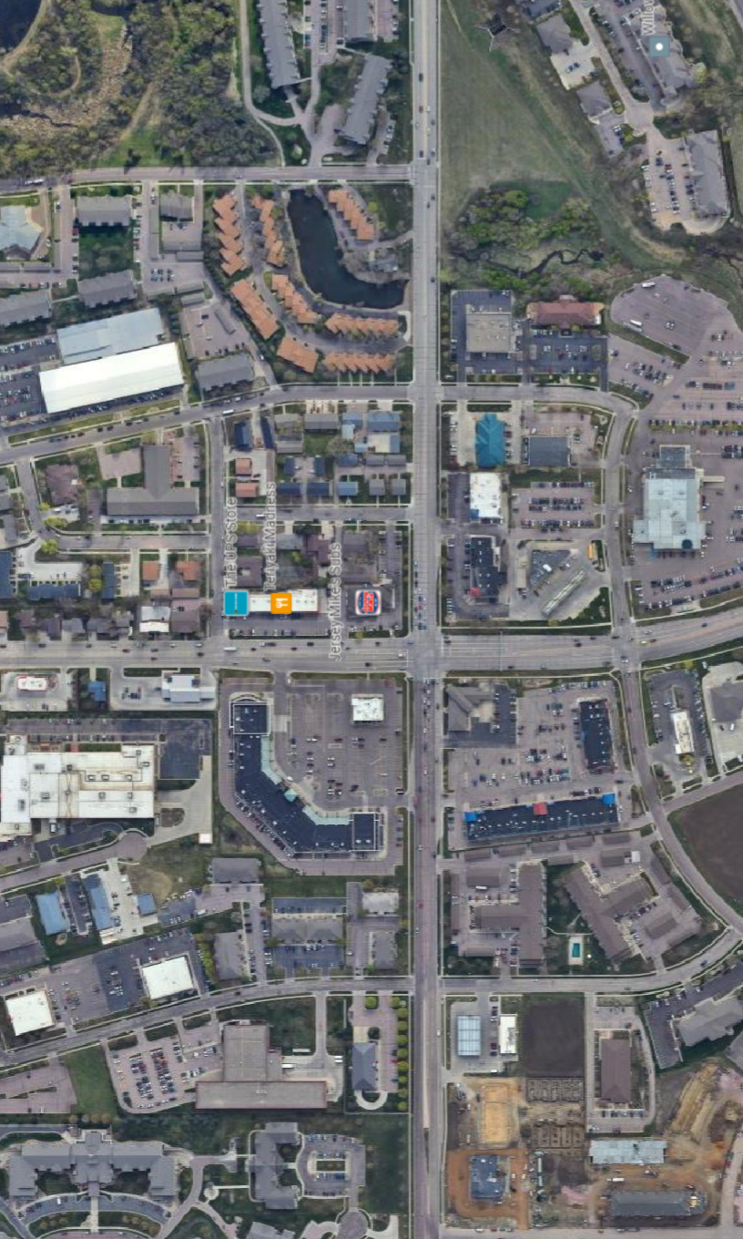
S Oxbow Ave
The Shoppes at 57th and Louise
Office | Retail
S Tennis Ln
AVAILABLE SPACE
Louise Ave
59th St
S Techlink Cir
Samuel Assam | President & CEO
Phone: (605) 334-8040
Email: sam@assamcompanies.com
Address: 530 S. Phillips Ave, Sioux Falls, SD 57104
S Nevada Ave
S Technolopolis Drive
W 57th Street

Slide 5
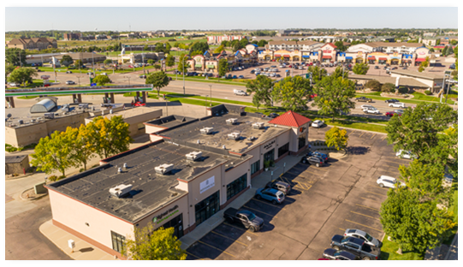
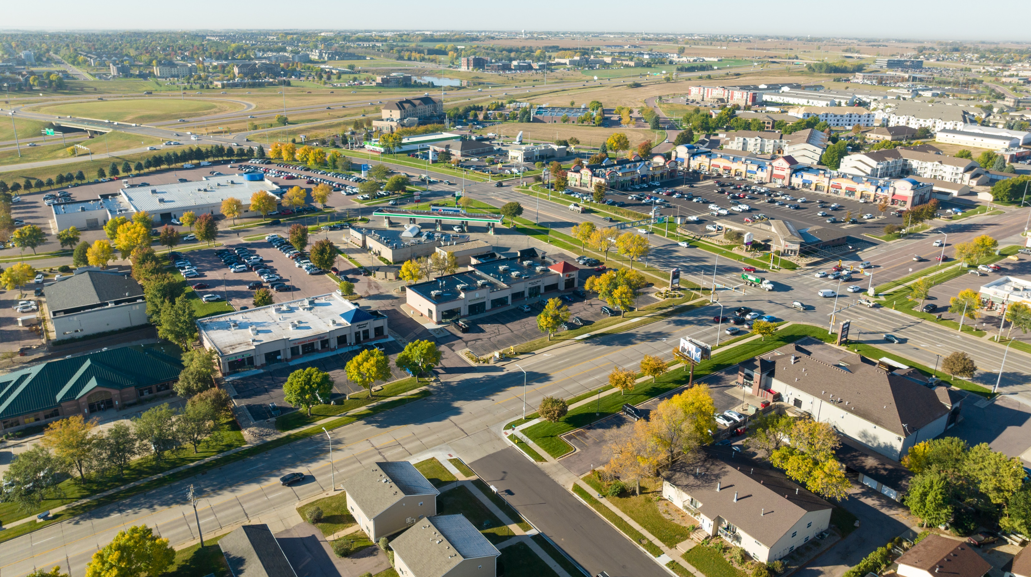
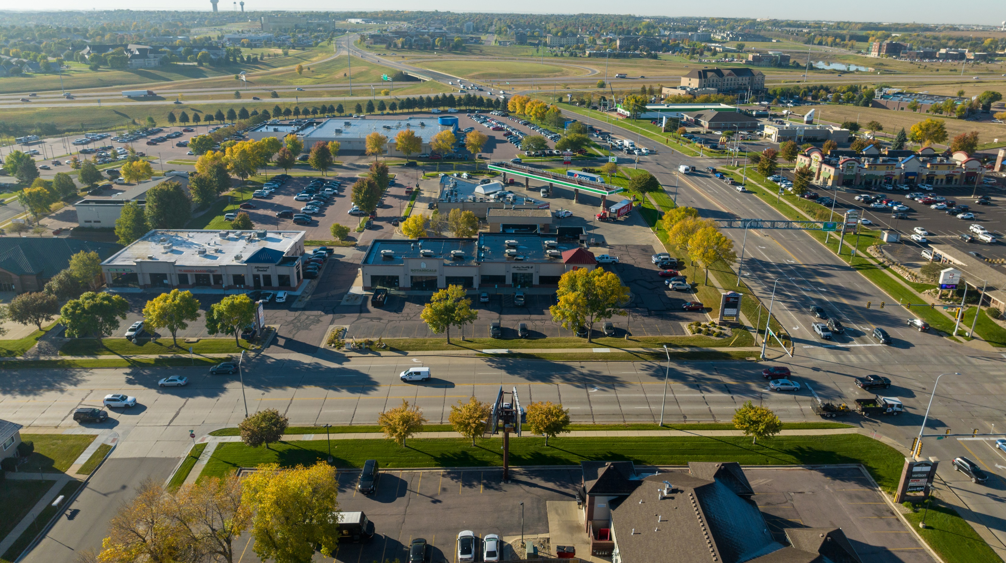
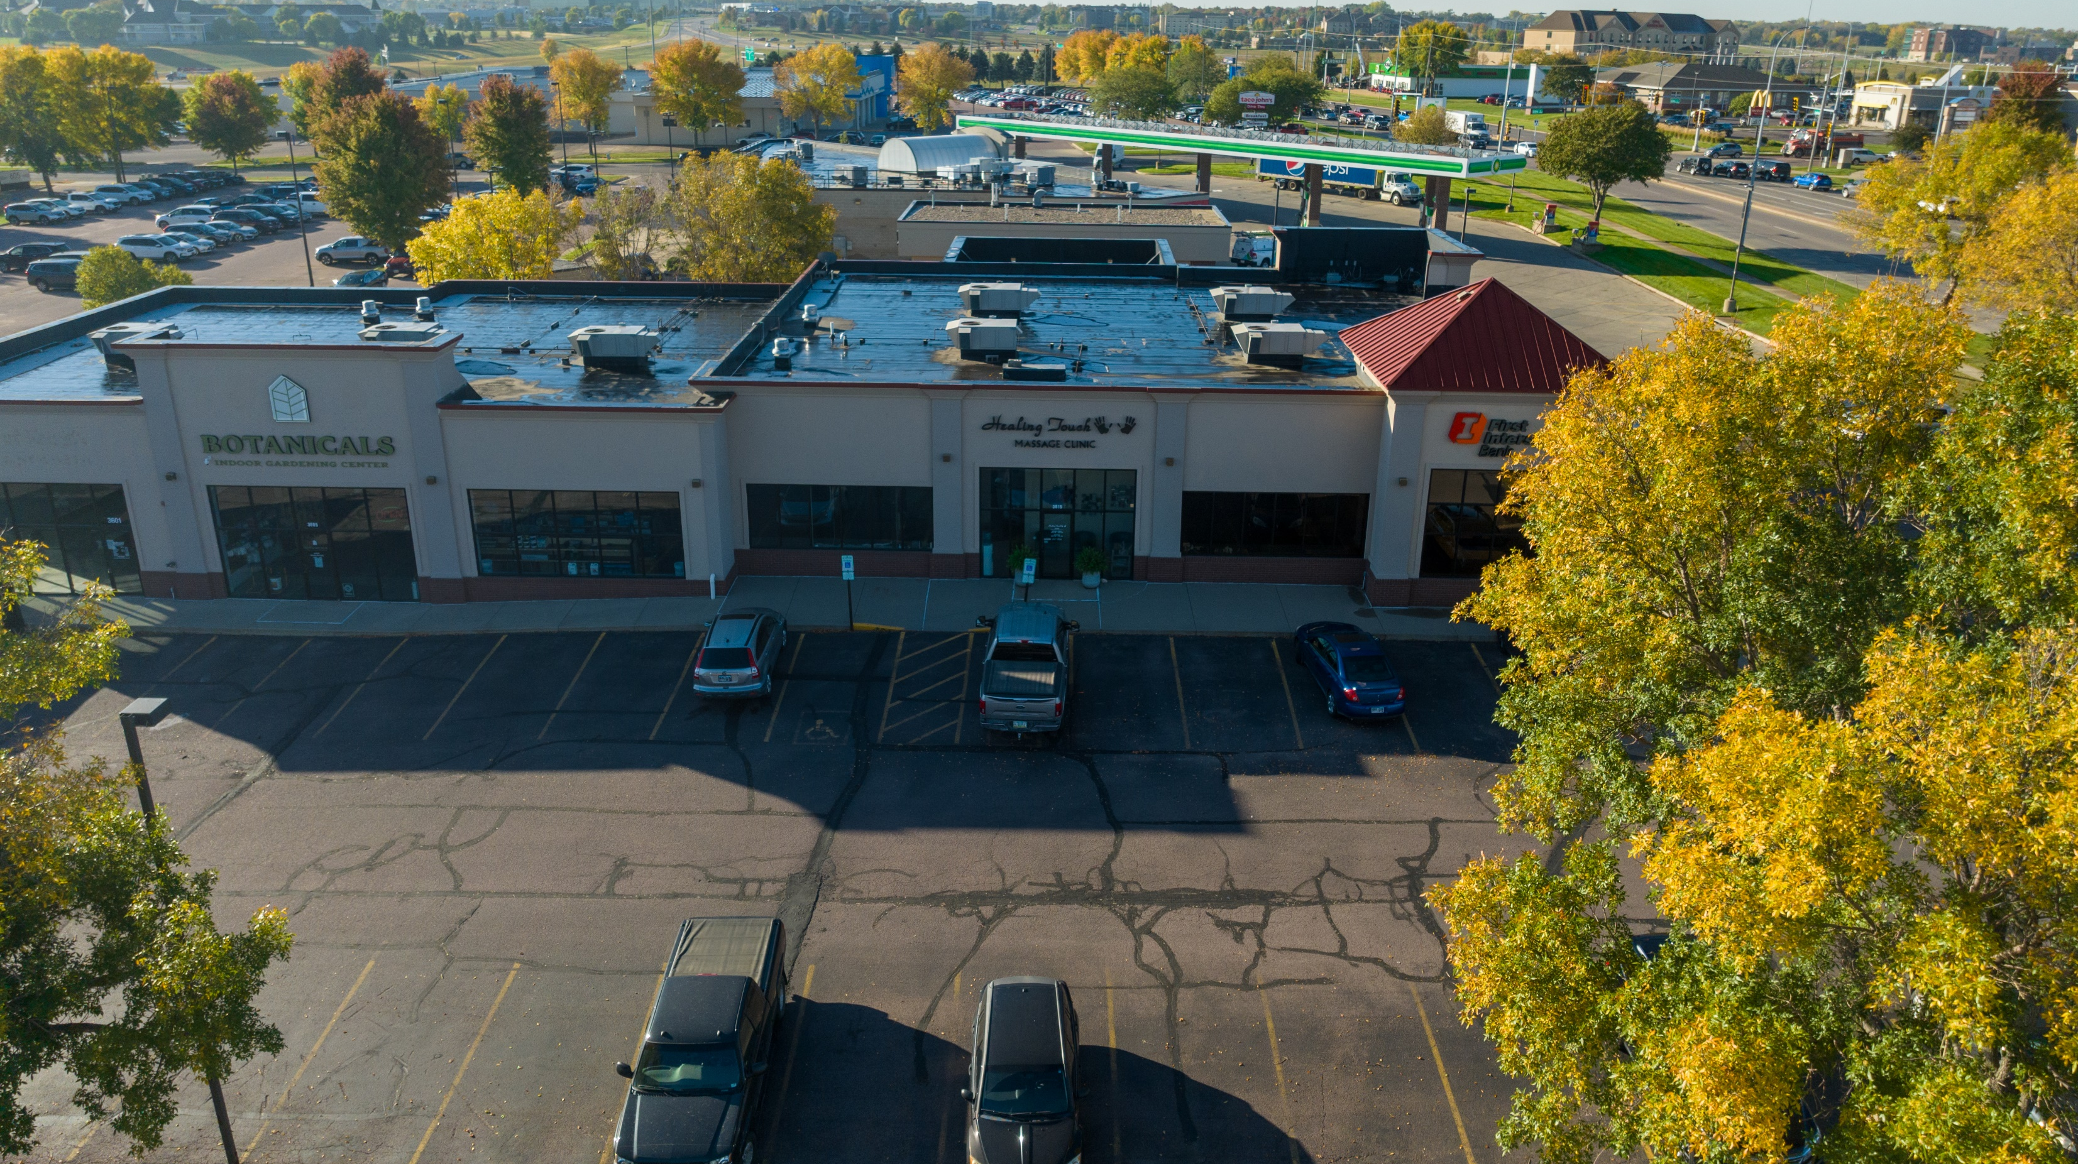
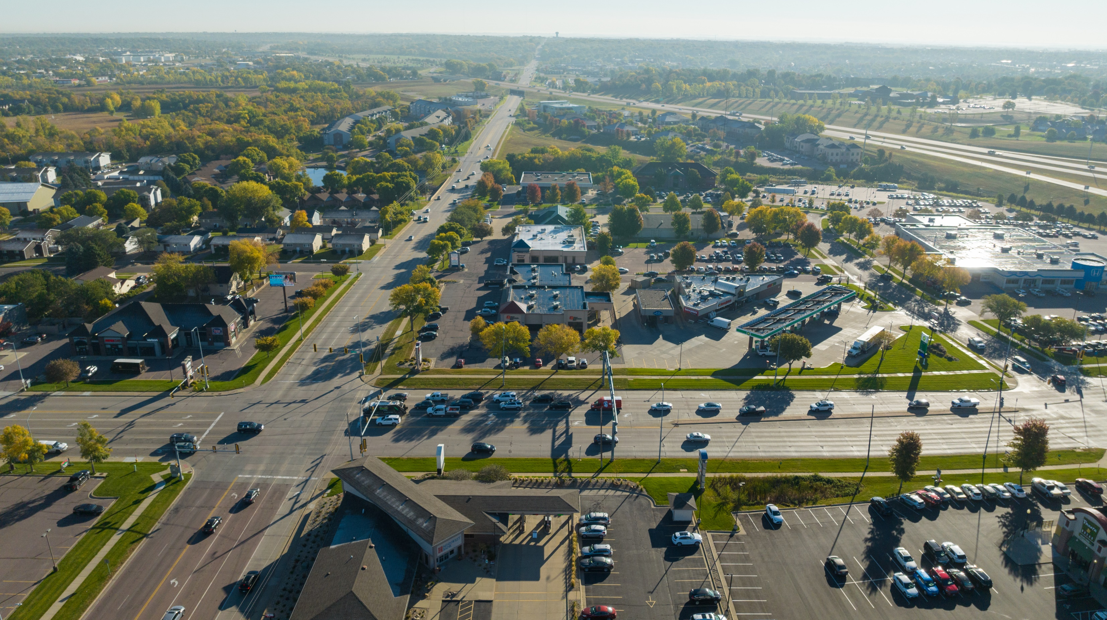
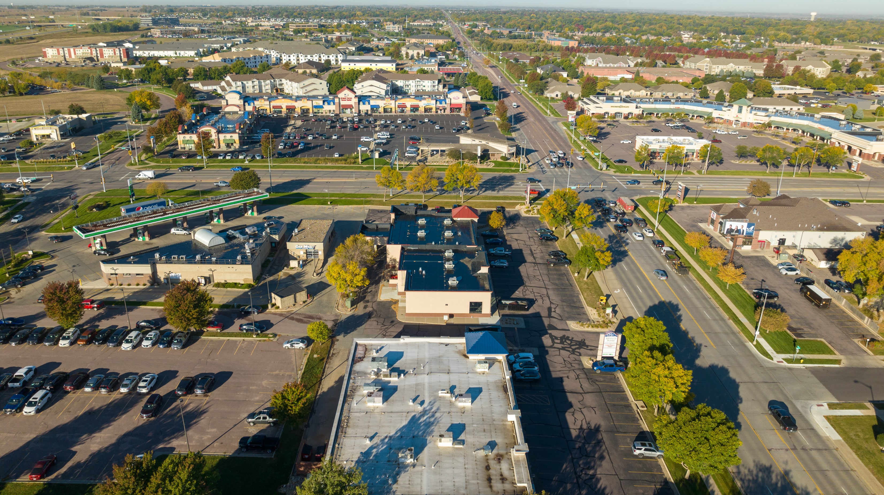
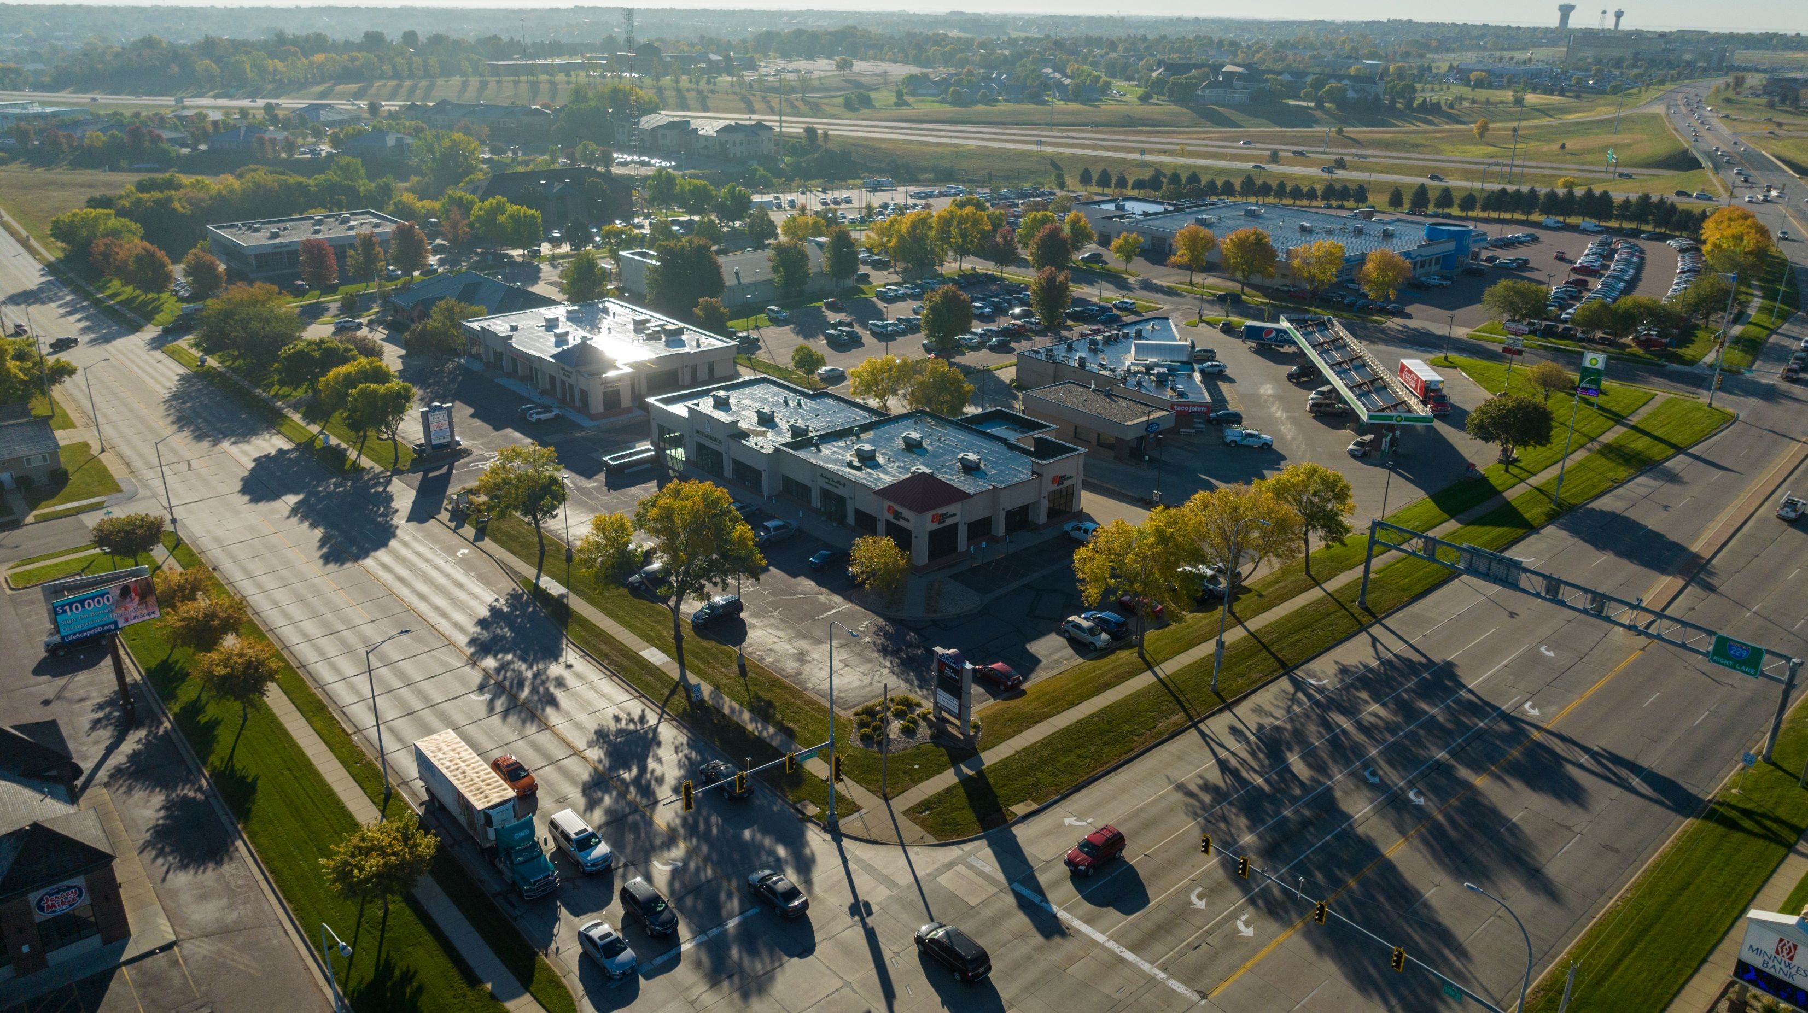
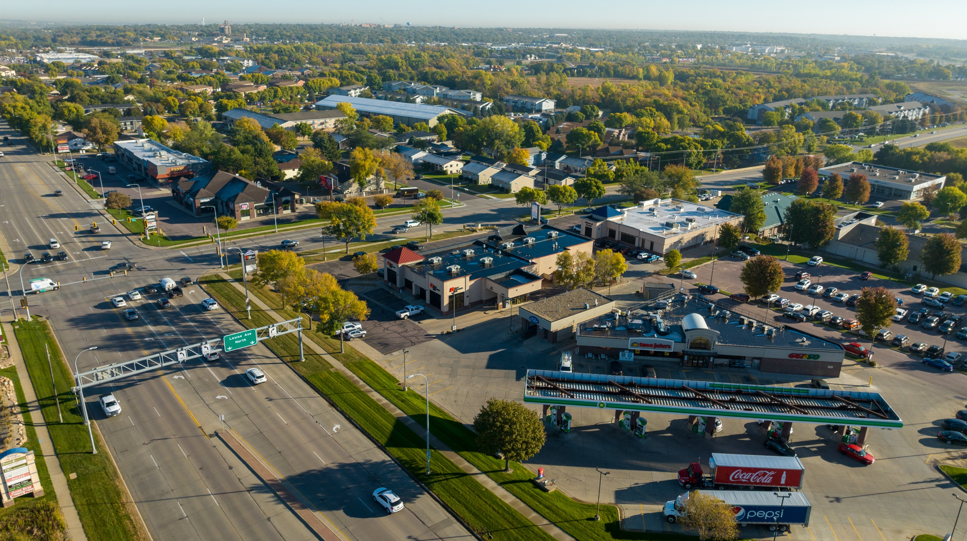
The Shoppes at 57th and Louise
Office | Retail
Photo Gallery
Samuel R. Assam | President
Phone: (605) 334-8040
Email: sam@assamcompanies.com
Address: 530 S. Phillips Ave, Sioux Falls, SD 57104

